Slide 1
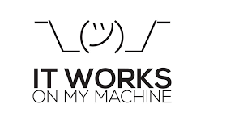
The "Why" - It works on my machine!
The Problem: You finish your project. It works perfectly on your Windows laptop with Python 3.14. You send it to a colleague who has a Mac and Python 3.10. It crashes.
The AI Specific Problem: AI libraries (PyTorch, TensorFlow, OpenCV) are very sensitive to versions. If one library is off by a tiny version number, the whole model might fail.
The Solution: Docker. Instead of just sending the code, you send a "Container" that includes the code, the Python version, and every single library installed exactly as you like it.

Slide 2
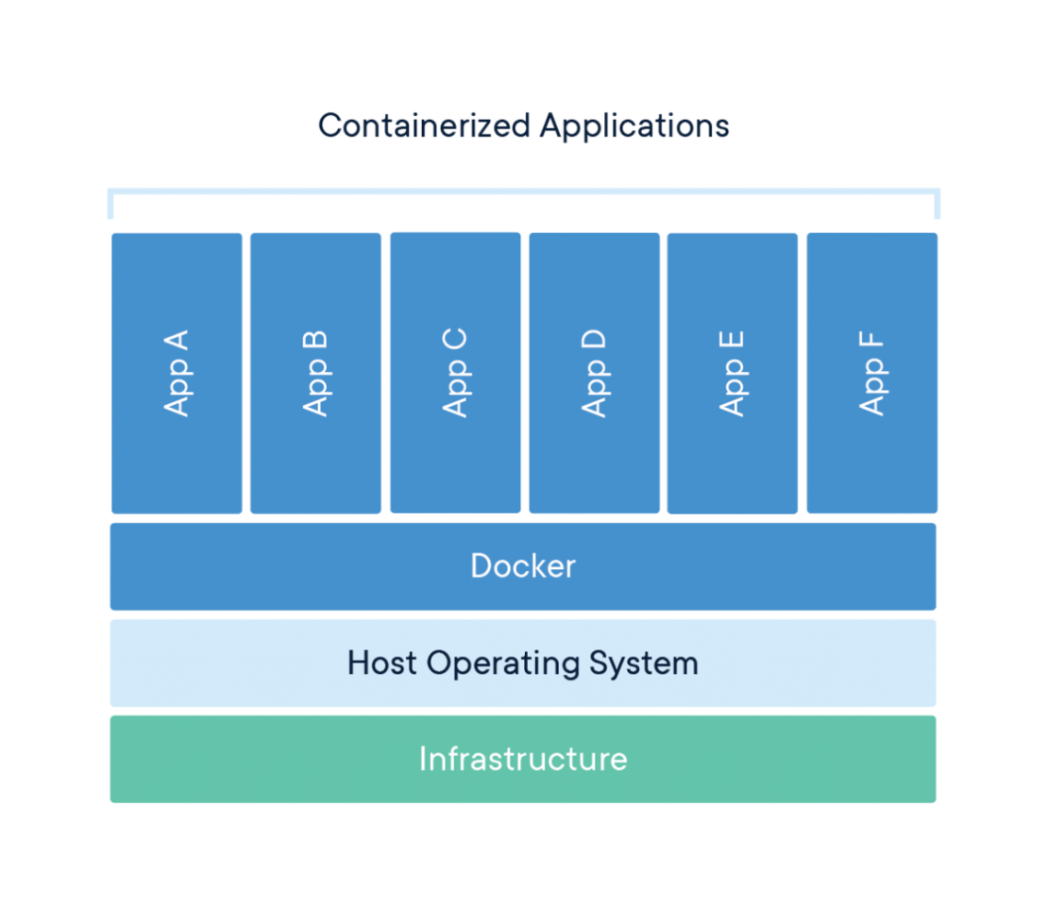
The "What" - The Shipping Container
Analogy: Before shipping containers, loading a boat was a mess. Now, every container is a standard size. You don't care if there are cars or coffee inside; the crane just picks it up.
Docker Image: This is your "Recipe" (The Blueprint).
Docker Container: This is the "Actual Cake" (The running instance of your code).
Docker Hub: The "Global Warehouse" where you store your images.

Slide 3
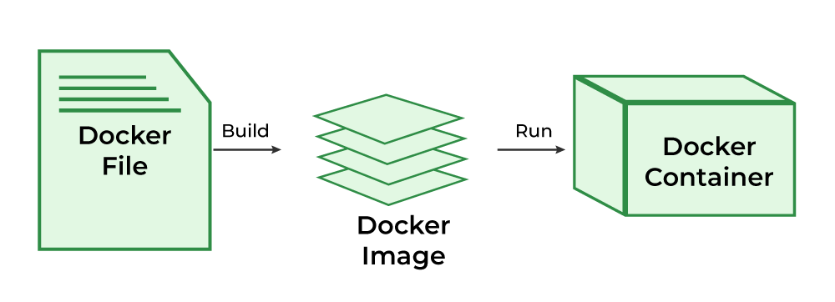
The "How" - The Dockerfile
To create a container, you write a Dockerfile. Think of this as a script that:
Starts a fresh, clean computer (the Base Image).
Installs Python.
Copies your code into it.
Runs your script.

